Slide 1
Parent meeting
2016-17 SEASON

Slide 2
About Us
WHO
7 members can be on a team
Students from kindergarten through university participate
Each team needs an adult Team Manager – Calling all Moms, dads, grandmas, grandpas, teachers, etc.
Team Managers help students stay on track but do not directly help the team develop its solution to the Destination Imagination (DI) Challenge

Slide 3
About Us
WHY
Teams in our program learn higher order thinking and improve in creative thinking, critical thinking and collaborative problem solving
Our participants experience the creative process, develop new friendships and learn to work together
DI identifies, celebrates and builds on a student's strengths
Teams learn important life skills like project management, collaboration, conflict resolution, and creative and critical thinking

Slide 4
About Us
HOW
Teams choose one of seven Challenges – see our website for the descriptions.
After weeks spent creating and developing their solutions, they go to the regional tournament.
Top-scoring teams advance to state, and the top tier goes to our Global Finals tournament—the world’s largest celebration of creativity 17,000+ attend Global Finals

Slide 5
Tournament
Regional: Feb. 25th AHS State: April 8th UWSP
At the tournament, teams will solve two types of Challenges: Team Challenges and Instant Challenges
Teams will present their Challenge solutions to a group of Appraisers
Appraisers are local volunteers who have been trained to assess the Challenges
Instant Challenges require teams to engage in quick, creative and critical thinking and only the team and team manager are present for the challenge.

Slide 8
Practices
WHEN
All teams should be up and running by Nov. 1 provided we have enough team managers.
Practice days and times are at the availability of team members and team manager.
Practices can take place in school or outside of school.
Teams typically spend 2 to 4 months developing and practicing their Challenge solutions after school and on weekends.

Slide 9
Important Dates
Mark your calendars:
Green Bay Area Regional Tournament
February 25, 2017
Ashwaubenon High School
Wisconsin Affiliate State DI Tournament
April 8, 2017
UW-Stevens Point
Stevens Point, WI

Slide 10
Forms
See your child’s school site under Activities and Clubs for all forms.
In order for your child to participate in DI you need to have turned in the following forms completely filled out by Sept. 30th:
Registration Form
DI fundraising options form
Pay your activity fee

Slide 11
Fundraising
Regionals:
100 Bags (or equivalent amount in boxes or loads) packed tightly full of discarded paper and corrugate
Work 2 paper drives per team / Elementary: Work on 2 hr. shift with your school's paper drive date.
1 box of candy bars per member
Promote Shell Gas Cards
Lambeau giveaways: required of high school/middle school teams.
(two people for one giveaway.)
State:
Another box of candy bars.
Global Finals:
2 boxes of Seroogy candy bars
work a summer paper drives
work preseason Packer giveaways
send letters out
shell cards
restaurant nights
sell water at graduation
TBD extra fundraisers as needed

Slide 12
Shell Gas Cards
How to order:

Slide 13
Globals
WHAT WE DO
Depart: Tuesday May, 24th
Return: Sunday May, 29th

Slide 14
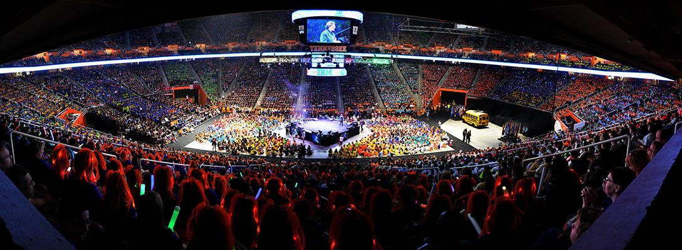
About Us
GLOBAL FINALS
“
DI is the best thing you will ever do for your child’s education, as well as for helping to shape his or her future as an innovator and leader.
– Melissa Dick,
Parent and Team Manager
”

Slide 15
Connect With DI & School Coordinator
“Like” us on Facebook at Destination Imagination, Inc.
& Ashwaubenon DI
Tweet with us @IDODI
*AHS Cordinator: Adrienne Luebke
aluebke@
*PV/PI Co-Coordinator: Jamie Lasee
jlasee@ashwaubenon.k12.wi.us
*PV/PI Co-Coordinator: Bonnie Luebke
*VV Coordinator: Diane Meinel
dmeinel@ashwaubenon.k12.wi.us
Follow us @boxandball for
creative inspiration
Share your photos
@boxandball
Join the conversation using #IamDI
Learn more at
DestinationImagination.org

Slide 16
THANK YOU

